Slide 1
FFT ALGORITHMS

Slide 2
Discrete Fourier transformation
Origin:
Fourier analysis is the decomposition of a function in terms of a sum of sinusoidal functions of different frequencies that can be recombined to obtain the original function.
DFT is one of the specific forms of Fourier analysis. The DFT is extremely important in the area of frequency (spectrum) analysis because it takes a discrete signal in the time domain and transforms that signal into its discrete frequency domain representation.
Properties:
Complexity of O(n² ) arithmetic operations

Slide 3
Fast Fourier Transform
A fast Fourier transform (FFT) is an efficient algorithm to compute the discrete Fourier transform (DFT) and its inverse.
An FFT is an algorithm computes DFT in only O(N log N) operations
These algorithms depend upon the factorization of N

Slide 4

Twiddle factor
Complex roots of unity called twiddle factors. n-th root of unity
A twiddle factor, in fast Fourier transform (FFT) algorithms, refers to the trigonometric constant coefficients that are multiplied by the data in the course of the algorithm. This term was apparently coined by Gentleman & Sande in 1966, and has since become widespread in thousands of papers of the FFT literature
More specifically, "twiddle factors" originally referred to the root-of-unity complex multiplicative constants in the butterfly operations of the Cooley-Tukey FFT algorithm, used to recursively combine smaller discrete Fourier transforms. This remains the term's most common meaning, but it may also be used for any data-independent multiplicative constant in an FFT.

Slide 5
FFT ALGORITHMS

Slide 6
Cooly-Tukey Radix-2 Algorithm
Cooly-Tukey Mixed Radix
Cooly-Tukey Radix-4
Cooly-Tukey Radix-8
Cooly-Tukey split Radix

Slide 7
Cooly-Tukey Radix-2 Algorithm
Cooly-Tukey Mixed Radix
Cooly-Tukey Radix-4
Cooly-Tukey Radix-8
Cooly-Tukey split Radix

Slide 8
Butterfly operator
In the context of fast Fourier transform algorithms, a butterfly is a portion of the computation that combines the results of smaller DFTs into a larger DFT, or vice versa (breaking a larger DFT up into sub transforms).
Most commonly, the term "butterfly" appears in the context of the Cooley-Tukey FFT algorithm, which recursively breaks down a DFT of composite size n = rm into r smaller transforms of size m where r is the "radix" of the transform. These smaller DFTs are then combined with a size-r butterflies, which themselves are DFTs of size r (performed m times on corresponding outputs of the sub-transforms) pre-multiplied by roots of unity (known as twiddle factors).

Slide 9
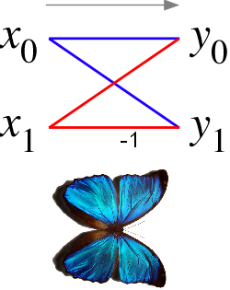
In the case of the radix-2 Cooley-Tukey algorithm, the butterfly is simply a DFT of size 2 that takes two inputs (x₀,x₁) and gives two outputs (y₀,y₁) by the formula (not including twiddle factors):
y₀ = x₀ + x₁
y₁ = x₀ − x₁
More generally, a DFT on n = 2^{p} inputs with respect to a primitive n-th root of unity relies on O(nlogn) butterflies of the form:
y₀ = x₀ + x₁ω^{i}
y₁ = x₀ − x₁ω^{i}

Slide 10
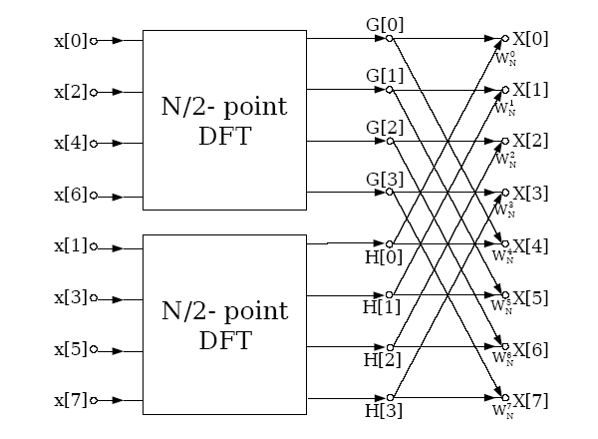

Slide 11
Cooly-Tukey Radix-2 Algorithm
Cooly-Tukey Mixed Radix
Cooly-Tukey Radix-4
Cooly-Tukey Radix-8
Cooly-Tukey split Radix

Slide 12
Cooly-Tukey Radix-2 Algorithm
Cooly-Tukey Mixed Radix
Cooly-Tukey Radix-4
Cooly-Tukey Radix-8
Cooly-Tukey split Radix

Slide 13
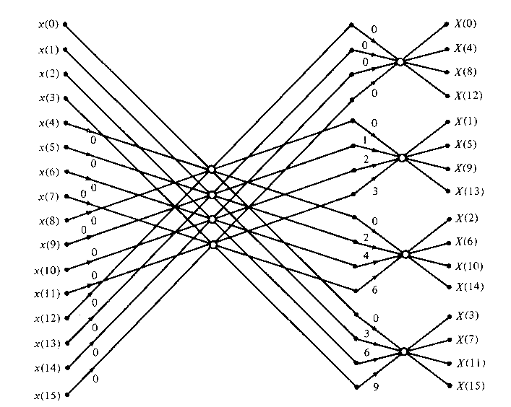
Figure TC.3.10 Sixteen-point radix-4 decimation-in-time algorithm with input in normal order and output in digit-reversed order,

Slide 14
Cooly-Tukey Radix-2 Algorithm
Cooly-Tukey Mixed Radix
Cooly-Tukey Radix-4
Cooly-Tukey Radix-8
Cooly-Tukey split Radix

Slide 15
Cooly-Tukey Radix-2 Algorithm
Cooly-Tukey Mixed Radix
Cooly-Tukey Radix-4
Cooly-Tukey Radix-8
Cooly-Tukey split Radix

Slide 16
Diagram for Radix-2 & Radix-4
Diagram

Slide 17
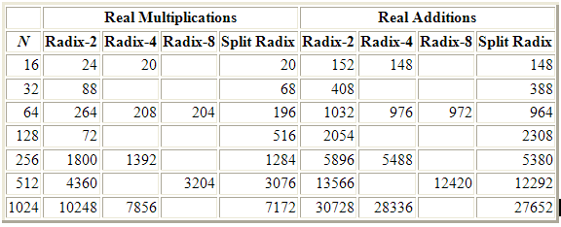
Comparison

Slide 18
References
Computational Frameworks for the Fast Fourier Transform
-Charles Van Loan
Web links:
http://en.wikipedia.org/wiki/Twiddle_factor
http://en.wikipedia.org/wiki/Butterfly_diagram
http://www.cmlab.csie.ntu.edu.tw/cml/dsp/training/coding/transform/fft.html
http://www.cmlab.csie.ntu.edu.tw/cml/dsp/training/coding/transform/fft.html
http://www.answers.com/topic/memory-locality?cat=technology

